Slide 1
Introduction to Database

Slide 2
Introduction to Database
What is the difference between Data and Information?
Data is a raw and unorganized fact that is required to be processed to make it meaningful.
Information is a group of data that collectively carries a logical meaning.
What is a Database?
A database is a systematic collection of data. They support electronic storage and manipulation of data. Databases make data management easy.

Slide 3
Introduction to Database
Types of Databases
Relational databases:
This type of database defines database relationships in the form of tables. It is also called Relational DBMS,
Example: MySQL,Oracle etc
Object-oriented databases:
This type of database supports the storage of all data types. The data is stored in the form of objects. The objects to be held in the database have attributes and methods that define what to do with the data. PostgreSQL is an example of an object-oriented relational DBMS.

Slide 4
Introduction to Database
Hierarchical:
This type of DBMS employs the “parent-child” relationship of storing data. Its structure is like a tree with nodes representing records and branches representing fields.
NoSQL databases:
NoSQL database is used for large sets of distributed data. There are a few big data performance problems that are not effectively handled by relational databases. This type of database is very efficient in analyzing large-size unstructured data.

Slide 5
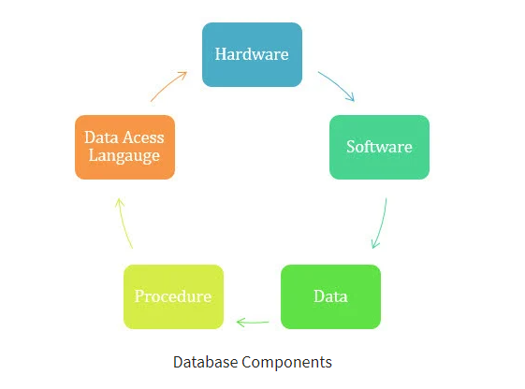
Introduction to Database
Database Components

Slide 6
Introduction to Database
What is Database Management System?
It is a collection of programs that enable its users to access databases, manipulate data, report, and represent data. It also helps to control access to the database.

